Slide 1
Particle System

Slide 2
Physics Review: force, mass, acceleration, velocity, position
a
m
f
v’
v
vave
a

Slide 3
Physics Review: Gravity

Slide 4
Physics Review: Other forces
Static friction
Kinetic friction
Viscosity
for small objects
No turbulence
For sphere

Slide 5
Physics Review: Spring-damper
Hooke’s Law

Slide 6
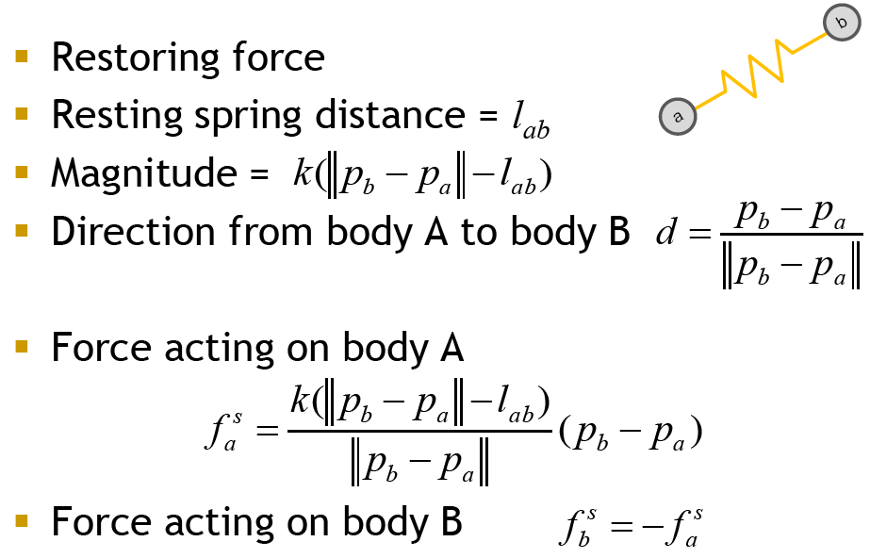
Spring Force: vector form

Slide 7
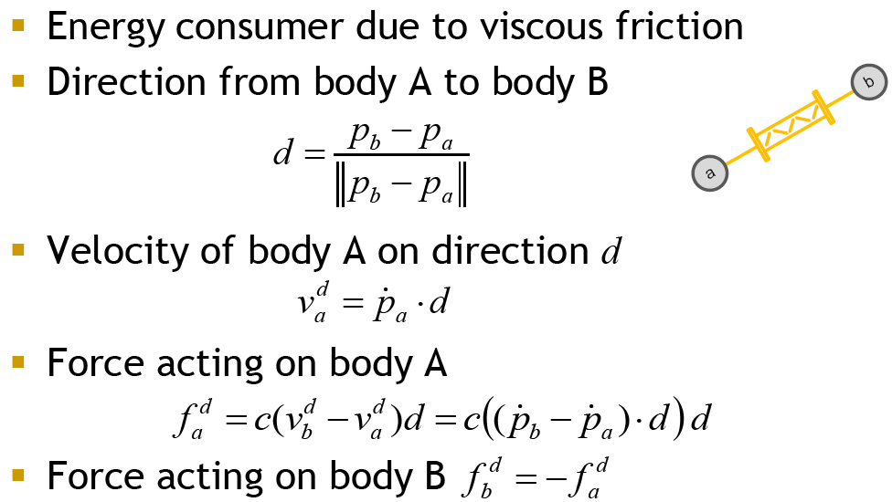
Damper Force: vector form

Slide 8
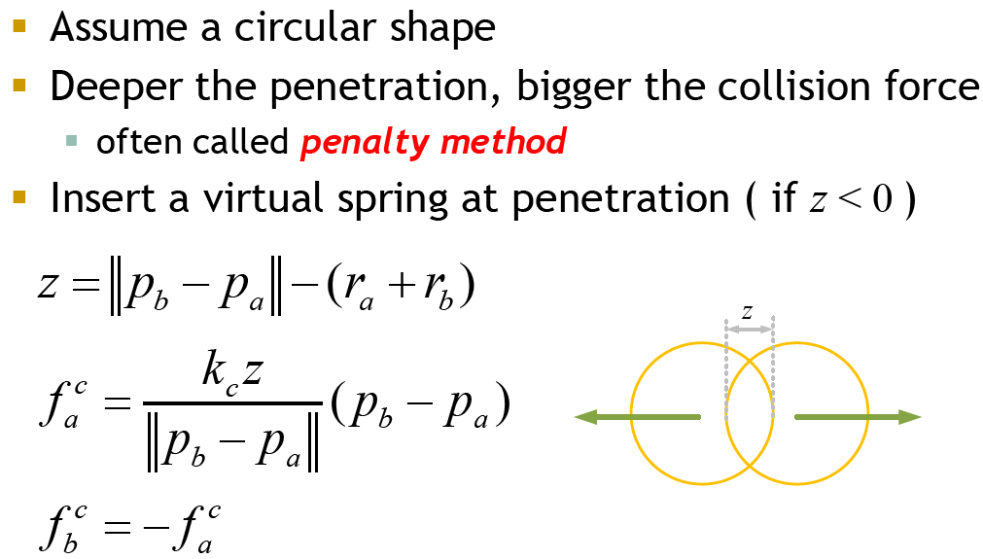
Collision Force: vector form

Slide 9
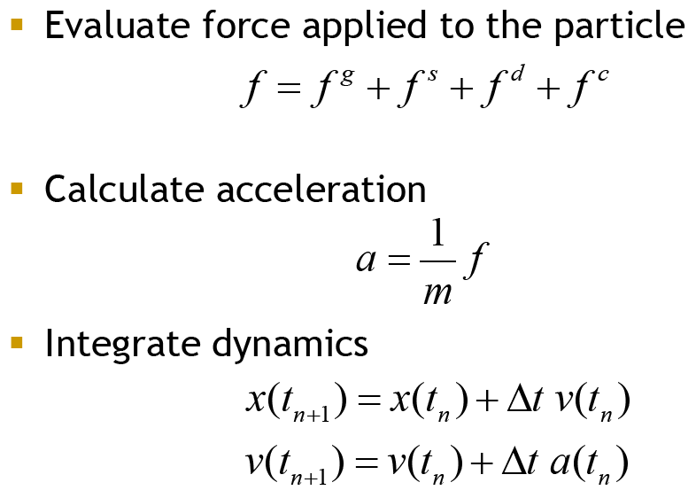
Forward Dynamics

Slide 10
Momentum
conservation of momentum (mv)
In a closed system, momentum is conserved
After collision has same momentum as before collision

Slide 11
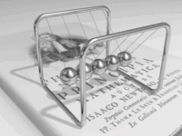
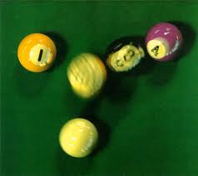
Elastic Collisions
No energy lost (e.g. deformations, heat)

Slide 12
Elastic Collisions & Kinetic Energy
As in all collisions: momentum is conserved
In elastic collisions, kinetic energy is also conserved

Slide 13
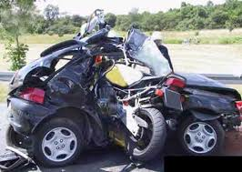
Inelastic Collisions
Kinetic energy is NOT conserved

Slide 14
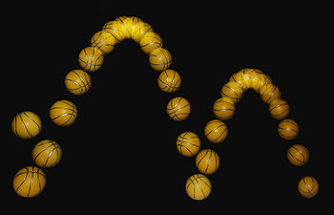
Inelastic Collisions
Kinetic energy lost to deformation and heat
Momentum is conserved
Coefficient of restitution
ratio of velocities before
and after collision

Slide 15
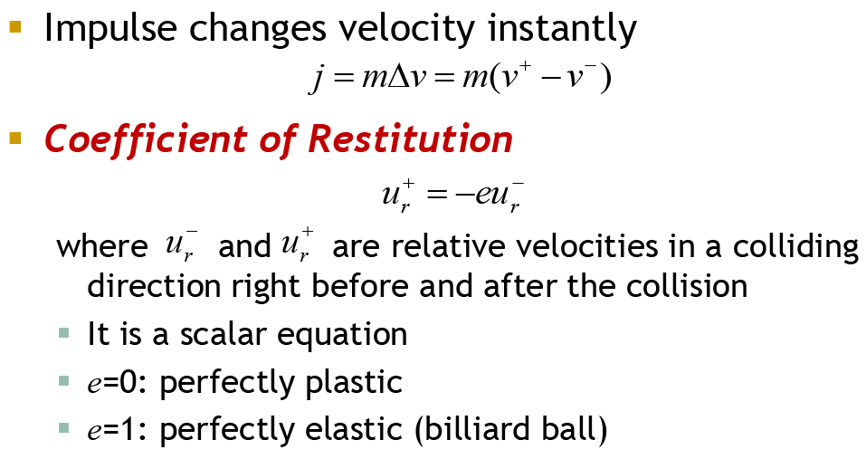
Impulse Dynamics

Slide 16
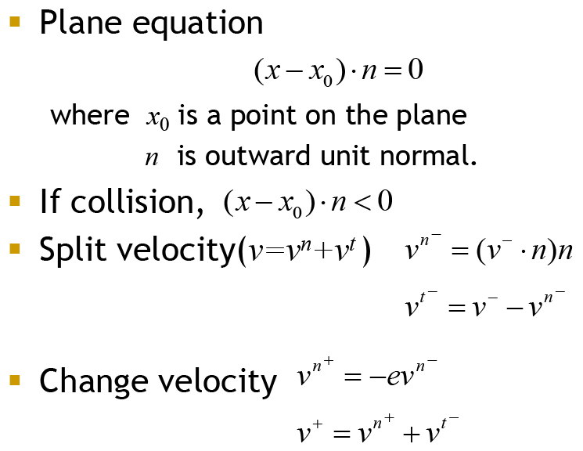
Collision: Particle vs. Plane

Slide 17
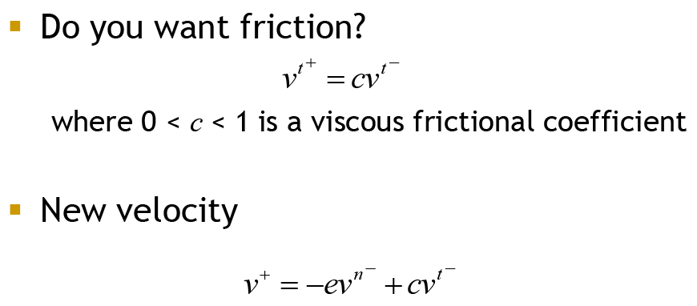
Collision: Particle vs. Plane

Slide 18
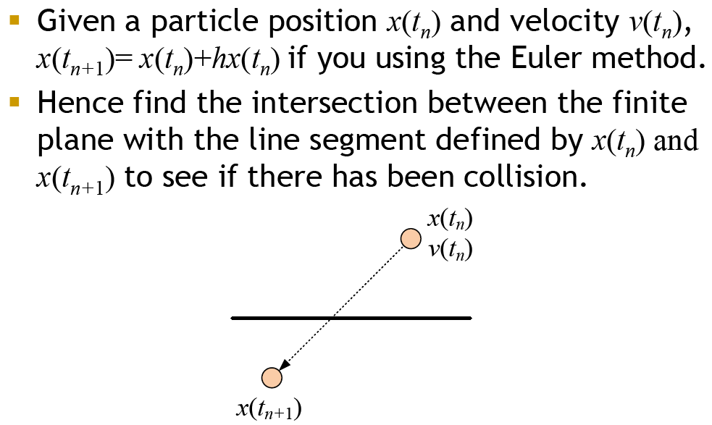
Collision: Particle vs. Plane

Slide 19
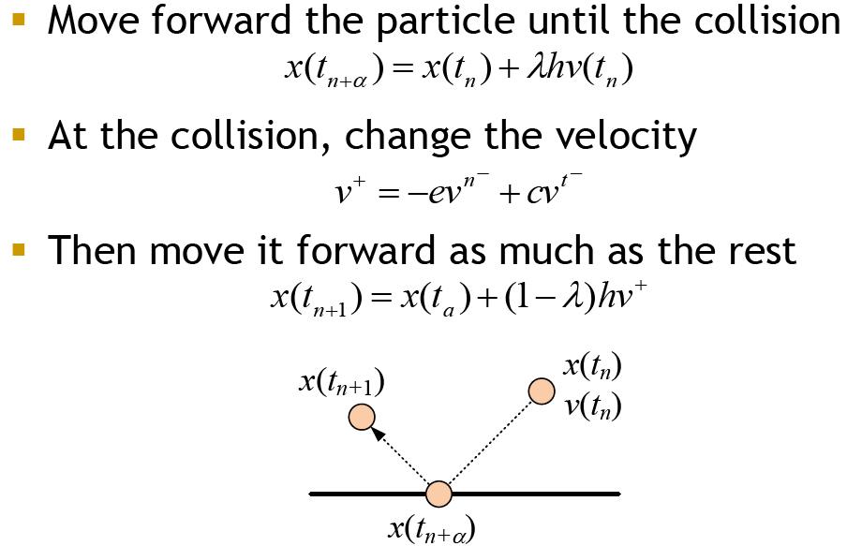
Collision: Particle vs. Plane

Slide 20
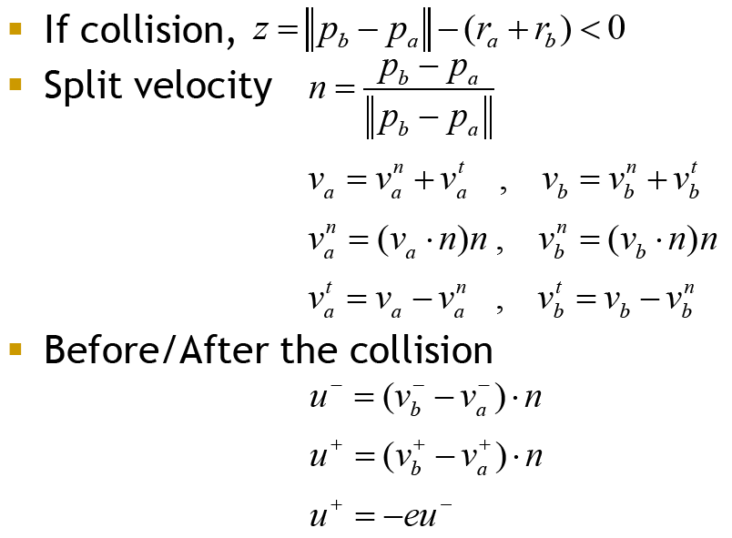
Collision: Particle vs. Particle

Slide 21
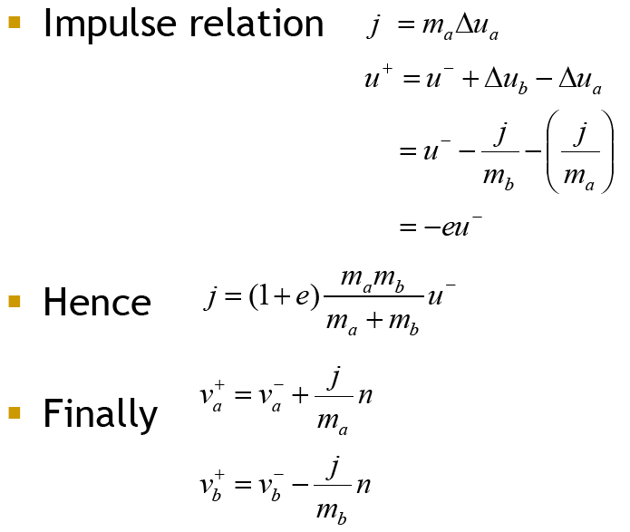
Collision: Particle vs. Particle

Slide 22
Springs
Flexible objects
Cloth
Virtual springs
Proportional derivative controllers (PDCs)

Slide 23
Spring-Mass-Damper System
f
-f

Slide 24
Spring-Mass System
V₃
E₃₁
E₂₃
V₂
V₁
E₁₂
Force

Slide 25
“Virtual” edge springs system

Slide 26
Angular springs
Linear spring between vertices
Dihedral angular spring

Slide 27
Spring Mesh
Each vertex is a point mass
Each edge is a spring-damper
Diagonal springs for rigidity
Angular springs connect every other mass point
Global forces: gravity, wind

Slide 28
Virtual Springs – Soft Constraints

Slide 29
Proportional (Derivative) Controllers
e.g., particle reacts to other forces while trying to maintain position on curve – virtual spring

Slide 30
Particle Systems
Lots of small particles - local rules of behavior
Create ‘emergent’ element
Particles:
Do collide with the environment
Do not collide with other partcles
Do not cast shadows on other particles
Might cast shadows on environment
Do not reflect light - usually emit it

Slide 31
Particle System
Collides with environment but not other particles
Particle’s midlife with modified color and shading
Particle’s demise, based on constrained and randomized life span
source
Particle’s birth: constrained and time with initial color and shading (also randomized)

Slide 32
Particle System Implementation
STEPS
for each particle
if dead, reallocate and assign new attributes
animate particle, modify attributes
render particles
Use constrained randomization to keep control of the simulation while adding interest to the visuals

